Slide 1
Citation Intent Detection System

Slide 2
Input: Title or DOI of paper (cited paper)
Output: List of citing paper along with list of citation sentence and the citation intent for each citation sentence.
Where we limit the range of search operation is that all of the citation, citing paper, cited paper are published in Journal (do not consider the Conference paper)

Slide 3

System-Step by step
title = "HeterGraphLongSum: Heterogeneous Graph Neural Network with Passage Aggregation for Extractive Long Document Summarization
search_box.send_keys(title)
# Nhấn Enter để tìm kiếm
search_box.send_keys(Keys.ENTER)
⇒Result:https://scholar.google.com/scholar?hl=en&as_sdt=0%2C5&q=HeterGraphLongSum%3A+Heterogeneous+Graph+Neural+Network+with+Passage+Aggregation+for+Extractive+Long+Document+Summarization&btnG=

Slide 4
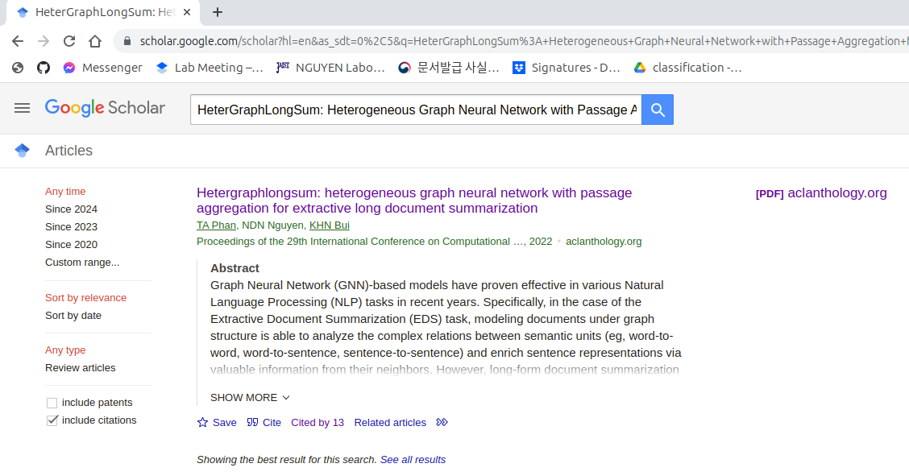
System-Step by step

Slide 5
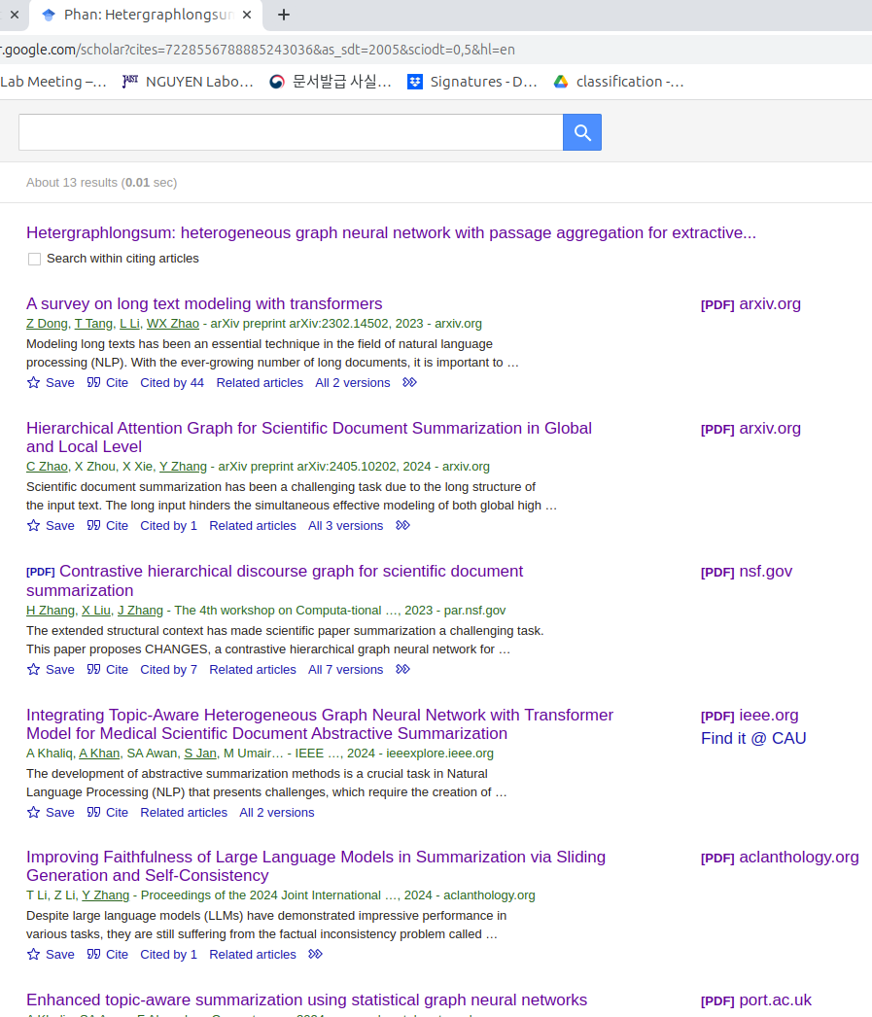
System-Step by step

Slide 6
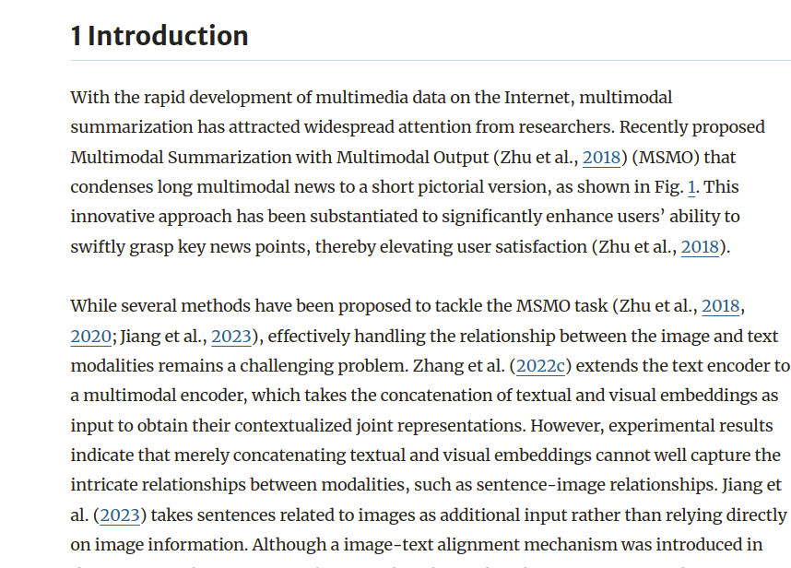
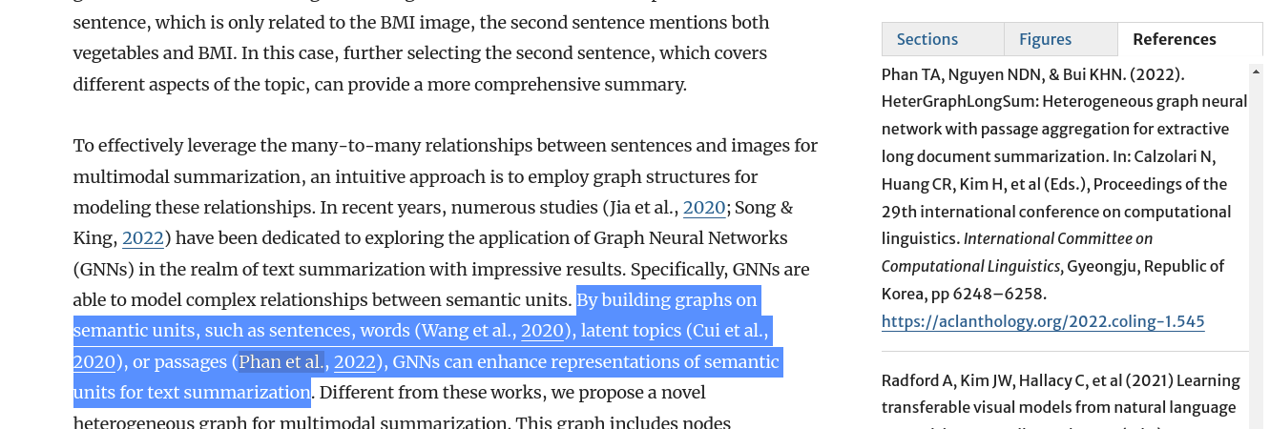
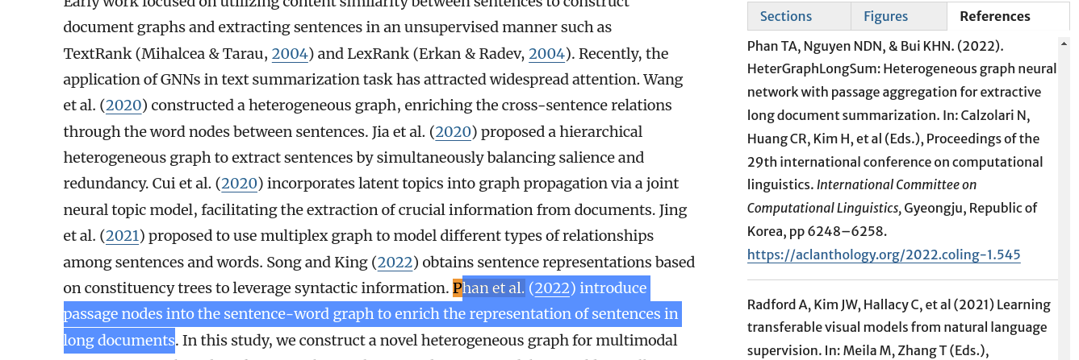
System-Step by step

Slide 7
Expected result (For one citing paper)
 | Heterogeneous graphormer for extractive multimodal summarization | Citation intent
Hetergraphlongsum: heterogeneous graph neural network with passage aggregation for extractive long document summarization | By building graphs on semantic units, such as sentences, words (Wang et al., 2020), latent topics (Cui et al., 2020), or passages (Phan et al., 2022), GNNs can enhance representations of semantic units for text summarization. | Background
 | Phan et al. (2022) introduce passage nodes into the sentence-word graph to enrich the representation of sentences in long documents | Background

Slide 8
Video Demo

